Slide 1
Digital Clock using LCD and Arduino
Simulating a real-time clock using millis() function
Presented by:
Mohammed Yahya
PDA college of engineering

Slide 2
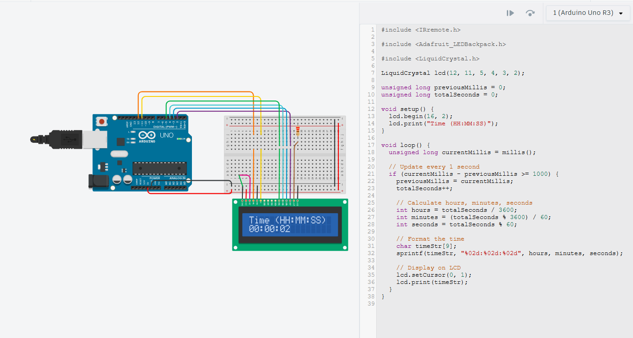

Slide 3
Objective
Objective of the Project:
To build a simple digital clock using an Arduino Uno.
To display time in HH:MM:SS format on a 16x2 LCD.
To simulate clock behavior without using a Real-Time Clock (RTC) module.

Slide 4
Components Required
Hardware:
Arduino Uno16x2
LCD Display10K
Potentiometer
Jumper Wires
Breadboard, USB Cable for Programming

Slide 5
Circuit Diagram
(Insert a schematic of Arduino connected to LCD) LCD Connections:
RS → Pin 12
EN → Pin 11
D4 → Pin 5
D5 → Pin 4
D6 → Pin 3
D7 → Pin 2
VSS, RW → GND
VCC → 5V
VO → Potentiometer middle pin

Slide 6
Working Principle
The millis() function returns the number of milliseconds since the Arduino board was powered on.
This value is used to calculate elapsed seconds, minutes, and hours.
The time is formatted using sprintf() and displayed on the LCD.The clock updates every second using time difference logic.

Slide 7
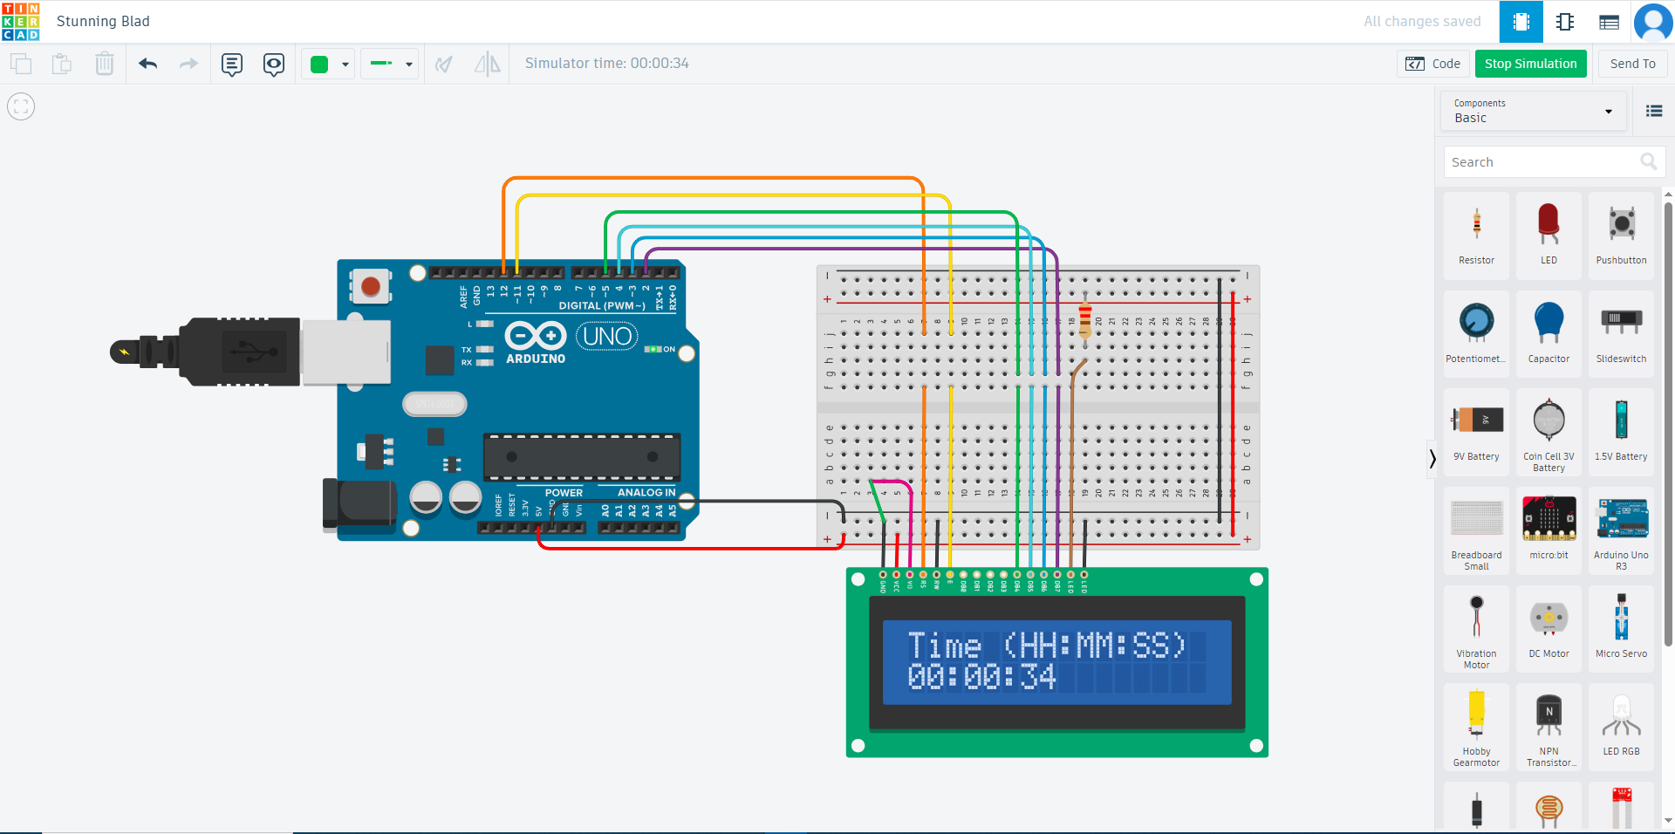

Slide 8
Code Explanation
Key Code Concepts:millis() to track time
LCD initialized using LiquidCrystal library
Time formatted as HH:MM:SS using string formatting
LCD updates once per second

Slide 10
Output
What it shows:
The top row: Title (“Time (HH:MM:SS)”)
The second row: Current time in hours, minutes, and seconds since start.

Slide 11
Conclusion
Successfully simulated a digital clock without RTC.
Demonstrated use of millis() for time tracking.
Can be upgraded with RTC module for real-time accuracy.

Slide 12
Thank You

